Slide 1
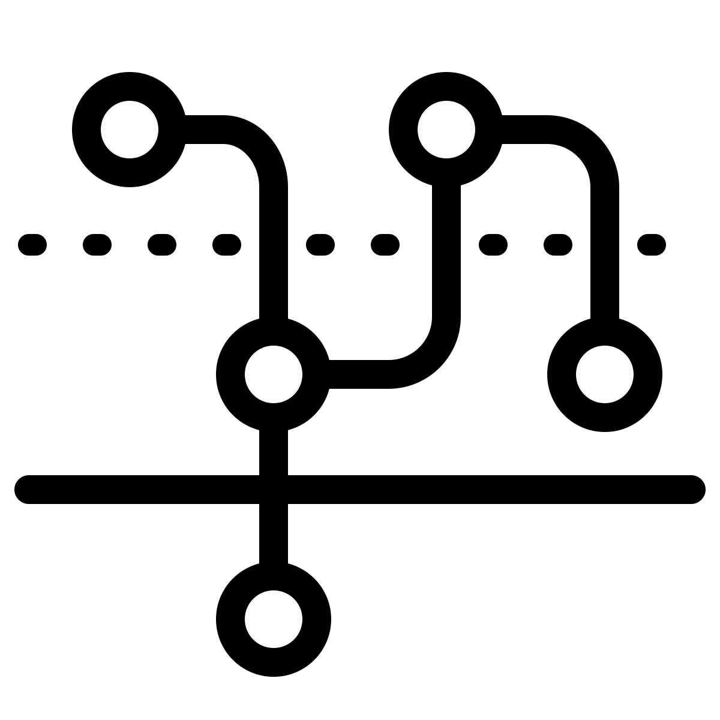
Android threading
2023-24

Slide 2
Managing concurrency
There are situations in which having a single flow of execution is problematic
When we need to leverage on all CPU cores, in order to speed up some computation
When we need to be able to perform other tasks while waiting for some I/O operation
To solve this problem, operating systems offer the thread abstraction
A thread is an independent computation flow, which is scheduled by the OS and operates inside a process
When a process starts, a single thread (the main one) operates inside it, but it may spawn other threads, that will share the addressing space, thus will be able to cooperate
While the abstraction is powerful, it comes with a lot of added complexity
In a concurrent program, there exist many more ways to write wrong code

Slide 3
Threads in Kotlin
Creating threads in Kotlin is simple: threads are instances of class java.lang.Thread
Their constructor accepts a java.lang.Runnable object (or a lambda function) representing the computation to be executed
Threads must be explicitly started(), in order to have them scheduled by the OS
val t = Thread{ println("This is a thread") }.also { it.start() }
Once started, a thread performs its computation until the end
Differently from what happens in other languages, if the computation fails, a message is logged but the process is not affected
While it is possible to wait for the termination of a thread via the .join() method, it is neither possible to return a value nor checking whether the computation failed or nor

Slide 4
Threads in Kotlin
In order to support the computation, each thread has its own stack where local variables and return addresses are stored
The maximum size of the stack may be set via a constructor parameter or is defined as a default value in the virtual machine executing the code
When two thread need to operate on a shared variable, synchronization must be set in place
Differently from Java, where each Object could operate as a synchronization primitive offering both the behavior of a mutex and that of a condition variable, in Kotlin class Any has been deprived of this behaviour
Depending on the specific context, several synchronization primitives may be adopted, both from the standard Java library (java.util.concurrent.*) and from the Android one (android.os.*)

Slide 5
Multi-threading in Android
When an application is started, the operating system creates a process and, inside it, a "main" thread
That manages all application components, distributing the events related to their life-cycle
This thread creates a message queue, initializes the objects defined in the manifest-file and then begins an infinite loop
It extracts a message from the queue and delivers it to its recipient
This may cause the insertion of new messages at the end of the queue

Slide 6
Multithreading in Android
Several other threads are spawned automatically from the main one: they are managed by the OS
Users never directly interact with them and hardly notice their presence
Their purpose is to support the execution abstraction either of the Dalvik/ART virtual machine or of the overall OS component framework

Slide 7
JVM-level threads
GC
Low priority garbage collection thread
JDWP
Support debugging and memory inspection
Compiler
Provide just in time compilation of code
ReferenceQueueD, FinalizerDeamon, FinalizerWatchd
Support object finalization and memory cleanup

Slide 8
Android system threads
Binder_X threads
Handle incoming intents and other IPC requests
Signal catcher
Handle quit, usr1 and usr2 Linux signals
GL updater
Handle hardware accelerated UI
hwUITask
Handle incoming messages from UI

Slide 9
The Android main thread
The main thread implements the Looper pattern
It manages a queue where messages are inserted both by itself and by other threads (including the system ones)
It continuously loops waiting for a message (if the queue is empty), extracting it, and processing its content
Out
Pseudo-code
val q = MessageQueue()
InitSystemObjects()
while (true) {
val m=q.getMessage()
dispatchMessage(m)
}
Message queue
In

Slide 10
The Android main thread
The main thread is responsible of
Instantiating the Application and Activity objects
Notifying them the events related to their life cycle
Sending drawing requests to the views
Delivering the events related to user interaction to the corresponding listeners
…as well as several other tasks
The access to the queue is synchronized
Other threads (including the operating system’s ones) may insert new messages...
... As long as there is no pending dispatching operation
In this case, the system waits a few seconds, then it forces the termination of the application

Slide 11
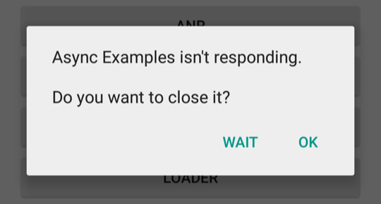
The Android main thread
It is necessary that all tasks, carried out in the main thread, terminate in a short time
To prevent the displaying of the "Application not responding" dialog box
If you need to perform a long-running task, you should either create a new thread…
And delegate to it its execution
…or use a coroutine
Which wraps the multi-threading subsystem with a set of abstractions that makes it easier to reason about concurrency

Slide 12
Programming abstractions
User programs may benefit of multithreading as well
Multithreading may be approached using the Java standard abstractions
Via the Thread class, and java.util.concurrent.* abstractions (locks, concurrent collections, cyclic barriers, atomic values, …)
In order to support the programmer in the development of concurrent programs, Android provides several useful abstractions
Like Looper and Handler
While these abstractions are highly reliable, since they represent the skeleton of the OS infrastructure, they are still very low level when compared with coroutines

Slide 13
Creating threads
Short running tasks may be implemented creating java.lang.Thread instances
Delegating a Runnable object to express the code to be executed
Once started, they run to completion
I.e., until their run() method returns
Thread objects do not return any value
In order to know the result of their computation, a value should be stored in some shared variable, raising the problem of locking

Slide 14
Creating threads
val t= Thread {
//the code here will be executed
//in a secondary thread
}
t.start();
//… other operations
try {
t.join(); // wait for thread termination
} catch (ie: InterruptedException ) {
Thread.currentThread().interrupt();
}

Slide 15
The Kotlin thread(…) function
fun thread(
start: Boolean = true,
isDaemon: Boolean = false,
contextClassLoader: ClassLoader? = null,
name: String? = null,
priority: Int = -1,
block: () -> Unit
): Thread

Slide 16
Accessing shared state
When two (or more) threads need to access the same variable a conflict may arise
Read-Modify-Write operations may lead to inconsistent values
A lock can be used to guarantee mutual exclusion between threads
Only one thread at a time can hold the lock
If other threads are willing to hold it, they are temporarily suspended, until the one holding it leaves the block

Slide 17
Accessing shared state
class SharedObject {
private var sharedValue=0
fun increment(): Int {
return synchronized(this) { ++sharedValue }
}
fun decrement(): Int {
return synchronized(this) { --sharedValue }
}
fun getValue(): Int {
return synchronized(this) { sharedValue }
}
}

Slide 18
Problems related to threads
All threads access the same address space
In particular, there is only a single heap where objects are allocated
If an object reference is known to two or more threads, the object is shared
The threads may communicate storing values in its attributes
This gives rise to interference, leading to unexpected results, if no synchronization is performed

Slide 19
Problems related to threads
By default, threads do not provide ways to communicate asynchronously among them
Accessing a shared state is the only viable solution
If a thread needs to know whether some state has changed, either polling or blocking waiting is to be used
Making it difficult to keep things working efficiently

Slide 20
Problems related to threads
Secondary threads are not aware of the application lifecycle
Nor of any other callbacks received inside the main thread
A part of the Android framework is ONLY accessible from the main thread
Typically, the View hierarchy
Any attempt to perform operations entailing this kind of objects from a secondary thread will give rise to an exception, terminating the current process

Slide 21
Problems related to threads
Thread are extremely easy to create, but hard to cancel
The only supported mechanism for thread cancellation relies on cooperatively polling the interrupted flag provided by Thread objects
But its semantics is complex and it is subject to a large number of border cases that need manual intervention by the programmer

Slide 22
Dealing with asynchronous tasks in Android
Thread + Synchronization
Java native
Android extensions
3rd party libraries
Callback
Reactive Streams
Kotlin only
Coroutines

Slide 23
Android threading extensions
Looper / Handler / MessageQueue
Mechanism on which all applications are built
Robust and powerful
Complex
AsyncTask
Formerly proposed as a general solution
Now deprecated
Coroutines
Kotlin-only powerful solution

Slide 24

The low-level Looper API
Java thread
Handler
N
1
Looper
Handler
Handler
Handler
1
1
Message Queue
Message
1
N
Message
Message

Slide 25
android.os.Looper
Class that manages a message queue associated with a single thread
The queue is not directly accessible to the programmer, but is it created through the Looper.prepare() static method
The thread that invokes this method becomes the owner of the queue
When the Looper.loop() static method is called, an infinite loop starts, waiting for messages from other threads
The main thread of an application is built with this schema

Slide 26
android.os.Looper
class MyLooper :Thread() {
private lateinit
var h : Handler
private
val cdl = CountDownLatch(1)
override fun run(){
Looper.prepare()
h = MyHandler()
cdl.countDown()
Looper.loop()
}
fun getHandler(): Handler {
cdl.await()
return h
}
}
Creates a queue associated with the current thread
Creates a message processor, through which messages and tasks can be sent
Performs a loop that continuously waits (without consuming CPU) for the next message,
and then dispatches it

Slide 27
android.as.Looper
Generally, looper objects are only accessible from their own thread
Via method Looper.myLooper()
Main looper is an exception
It is accessible from any thread, via Looper.getMainLooper()
Loopers can be terminated via their quit() method
Or via quitSafely() (requires API 18+)

Slide 28
android.os.MessageQueue
Unbounded linked list of messages to be processed by the consumer thread
Every looper (and thread) has at most one MessageQueue
It is possible to retrieve the MessageQueue for the current thread via
Looper.myQueue()

Slide 29
android.os.Handler
A class that provides a thread-safe interface for inserting and processing of new requests in a looper queue
An Handler object is bound to the implicit queue associated with the thread in which it was created
The request may be constituted by a Runnable or a Message object
In the first case, the handler will execute the associated run() method
In the other case, it will process it via its own handleMessage(m: Message) method
In both cases, processing will happen inside the associated looper thread

Slide 30
android.os.Handler (2)
The requests can be queued immediately
post(r: Runnable)
sendMessage(m: Message)
... Or after a given time interval
postDelayed(r: Runnable, delay: Long)
postAtTime(r: Runnable, time: Long)
sendMessageDelayed(m: Message, delay: Long)
sendMessageAtTime(m: Message, time: Long)

Slide 31
android.os.Handler
The handler mechanism can be used to asynchronously communicate with a thread
Provided it is a looper
A looper thread can be associated with many different handler
But they all insert messages in the same queue
When the message will be picked up, it will be processed by the handler through which it was inserted

Slide 32
android.os.Message
Models an event described by an integer value, a pair of (integers) parameters and an eventual object to be delivered to the recipient
The use of integer values ​​makes the use (and reuse) of objects of this type efficient
Given the allocation and releasing cost of new items, the operating system maintains a queue of messages that are not in use
You get a message by invoking Message.obtain()
You can release it via the .recycle() method

Slide 33
The producer/consumer pattern
Looper threads naturally lend themselves to implement the producer/consumer pattern
A producer thread asynchronously generates pieces of information, storing them in Message objects
Messages are inserted in the MessageQueue of the consumer via the sendMessage() method provided by Handler
Looper (consumer) thread extracts one message at a time and dispatches it to the handler though which it was posted, in order to process it

Slide 34
The producer/consumer pattern
Producer
thread
Consumer thread
loop()
Handler
Looper
sendMessage(m)
handleMessage(m)
Message Queue

Slide 35
Managing typical problems
Only the main thread can access objects of the graphical interface
If a secondary thread tries to operate on them, the application is terminated with an exception
A mechanism that allows the secondary thread to notify its results to the main thread is required
The main thread will then show them
FATAL EXCEPTION: Thread-8 E/AndroidRuntime(374): android.view.ViewRoot$CalledFromWrongThreadException: Only the original thread that created a view hierarchy can touch its views.

Slide 36
Managing typical problems
Storing a value in an activity attribute is not usually a good solution
The main thread would not notice this change and, unless an external event that causes the redesign of the interface occurs, the view would remain unchanged
It is necessary that a new event is inserted in the message queue
When the main thread will process it, it will understand that the secondary thread has finished and what are its results

Slide 37
Sending messages to the main thread
Android provides five different alternatives
Each with its own strengths and weaknesses
activity.runOnUiThread(r: Runnable)
When this method is executed, if the current thread is not the main one, a new message that encapsulates the runnable is inserted into the queue
When the message will be processed, the main thread will executed it
It requires the secondary thread to hold a reference to the current activity (which could be a problem, should it finish…)

Slide 38
Sending messages to the main thread
view.postRunnable(r: Runnable)
Inserts the Runnable object in the message queue
It can be called from any thread as long as the view is displayed inside a window
view.postDelayed(r: Runnable, l: Long)
Similarly to the previous case, it inserts the object into the queue, but it will not be processed before an interval equal to the given number of milliseconds
In this case, too, the view must be connected to a window and be visible

Slide 39
Sending messages to the main thread
Use instances of the Handler class, created in the main thread, and queue messages via one of the following methods
sendMessage(…)
sendMessageDelayed(…)
sendMessageAtTime(…)
sendMessageAtFrontOfQueue(…)
Or request the execution of a runnable, via
post(…), postDelayed(…), postAtTime(…), postAtFrontOfQueue(…)

Slide 40
android.os.HandlerThread
Helper class that builds a secondary thread that incorporates a Looper and a MessageQueue
val ht= HandlerThread("HT"); ht.start();
val handler = Handler(ht.looper) {
when (it.msg) {
// Process messages here
}
return true
}

Slide 41
Incorporating an handler thread
Handler threads can safely be incorporated into standard components, binding their lifecycle to the component one
The HandlerThread is created in the onCreate() method and quitted in the onDestroy() one
By subclassing HandlerThread, it possible to expose convenience methods to simplify custom operations
While guaranteeing ordered execution of requested messages

Slide 42
HandlerThread subclassing
class MyHandlerThread(name:String): HandlerThread(name) {
private val cdl = CountDownLatch(1)
val handler : MyHandler by lazy {
cdl.await()
MyHandler(looper)
}
override fun onLooperPrepared() {
cdl.countDown()
}
}

Slide 43

Learning more…
A Comprehensive Guide to Android Multithreading: Unveiling the Power of Parallelism
https://medium.com/@aaarke/a-comprehensive-guide-to-android-multithreading-unveiling-the-power-of-parallelism-eb42b86361e3
Debugging of multithreading application
https://hyperskill.org/learn/step/38850
Programming Android with Kotlin: achieving structured concurrency with coroutines
O'Reilly, 2022 - ISBN: 9781492063001

